Slide 1

New York City Airbnb Listing Pricing Analysis
Team name: anonymous Team member: Hsiao-ting Tseng

Slide 2
Introduction
Question
What is the key factor which influences Airbnb listing price in New York City?
Goal
To find out the price trend for Airbnb listing in NYC
To develop a model to predict the prices for Airbnb listing in NYC
How
Implement correlation tests for exploratory variables: room type, borough, number of room, accommodate, overall satisfaction
Build a model to predict prices for Airbnb listings in NYC

Slide 3
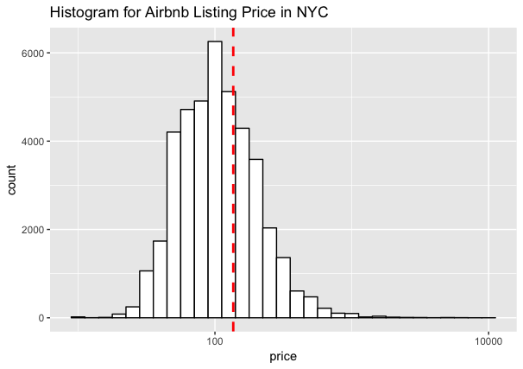
Exploratory Data Analysis
NYC Airbnb Listing Price Overview
Price range is huge:$0~$9,999
Average price: $136.1
Many extreme outliers

Slide 4
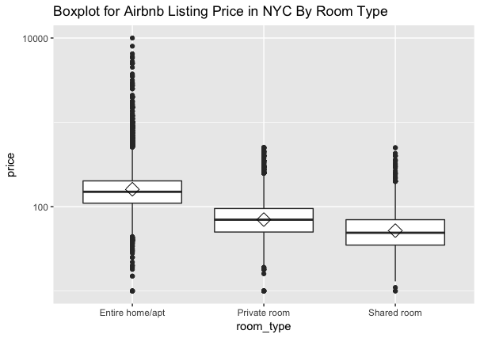
Exploratory Data Analysis
NYC Airbnb Listing Price by Room Type
1.Entire home/apt
Higher average price: $194.32
Lager price range: $10~$9,999
Higher standard deviation: 216.01
2.Shared room: Lower average price: $63.1
3. Private room and shared room have similar
Price range and closed standard deviation.

Slide 5
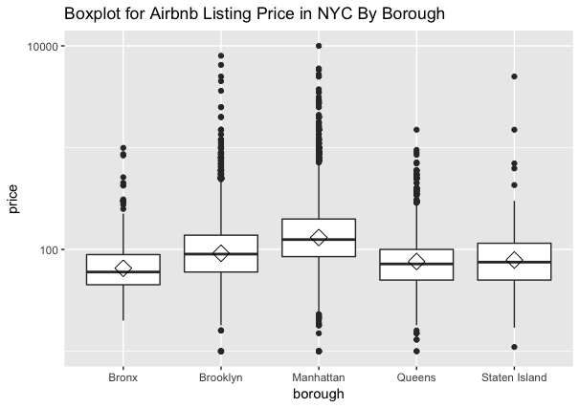
Exploratory Data Analysis
NYC Airbnb Listing Price by Borough
1.Manhattan has the highest average: $167
2.Manhatan and Brooklyn has similar huge
Price range and a lot of outliers
3.Staten Island has the largest standard
deviation: 314.17

Slide 6
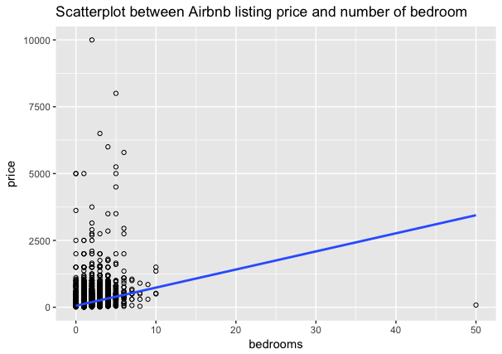
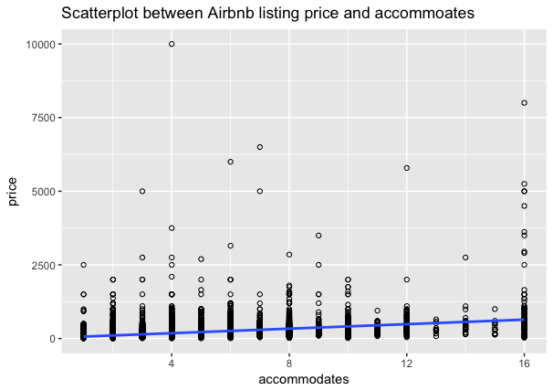
Exploratory Data Analysis
Price V.S. Number of room: Weak correlation:0.31
Price V.S. Accommodate: Modest correlation:0.42

Slide 7
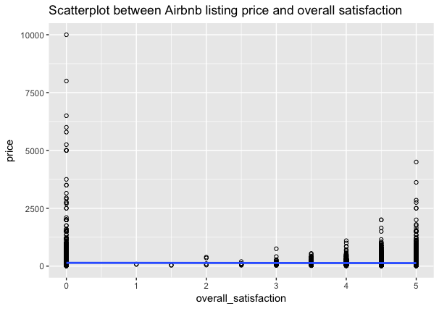
Exploratory Data Analysis
Price V.S. Overall Satisfaction
Weak correlation:0.02

Slide 8
Model building
Initial model
price = y0 (room type) +y1 (borough) + y2 (number of bedroom) +y3 (accommodates) + y4 ( overall satisfaction)+e
Best model
price = 14.74 (number of room)+34.53(accommodates)+20.4831
>> each variable pass Anova test

Slide 9
Conclusion
Current dataset is lack of listing description, host response rate, amenities(wifi, tv, dryer). This will be helpful for the exploratory data analysis
Bigger dataset, more variables to build more precise model

